Slide 1
Malignant Comments Classifier – Multi-Label Classification Project using NLP
Made by:
Vikas Kumar Mishra
Internship batch-32

Slide 2


Slide 3
Malignant Commentes Classifier - Multi Label Classification Project using NLP
The proliferation of social media enables people to express their opinions widely online. However, at the same time, this has resulted in the emergence of conflict and hate, making online environments uninviting for users. Although researchers have found that hate is a problem across multiple platforms, there is a lack of models for online hate detection.
Online hate, described as abusive language, aggression, cyberbullying, hatefulness and many others has been identified as a major threat on online social media platforms. Social media platforms are the most prominent grounds for such toxic behaviour.

Slide 4
Malignant Comments Classifier – Multi-Label Classification Project using NLP
There has been a remarkable increase in the cases of cyberbullying and trolls on various social media platforms. Many celebrities and influences are facing backlash from people and have to come across hateful and offensive comments. This can take a toll on anyone and affect them mentally leading to depression, mental illness, self-hatred and suicidal thoughts.
Internet comments are bastions of hatred and vitriol. While online anonymity has provided a new outlet for aggression and hate speech, machine learning can be used to fight it. The problem we sought to solve was the tagging of internet comments that are aggressive towards other users. This means that insults to third parties such as celebrities will be tagged as unoffensive, but “u are an idiot” is clearly offensive.

Slide 5
Problem Statement
Our goal is to build a prototype of online hate and abuse comment classifier which can be used to classify hate and offensive comments so that they can be controlled and restricted from spreading hatred and cyberbullying.

Slide 6
Multi-Label Classification Problem
Difference between multi-class classification & multi-label classification is that in multi-class problems the classes are mutually exclusive, whereas for multi-label problems each label represents a different classification task, but the tasks are somehow related.
For example, multi-class classification makes the assumption that each sample is assigned to one and only one label: a fruit can be either an apple or a pear but not both at the same time. Whereas, an instance of multi-label classification can be that a text might be about any of religion, politics, finance or education at the same time or none of these.

Slide 7
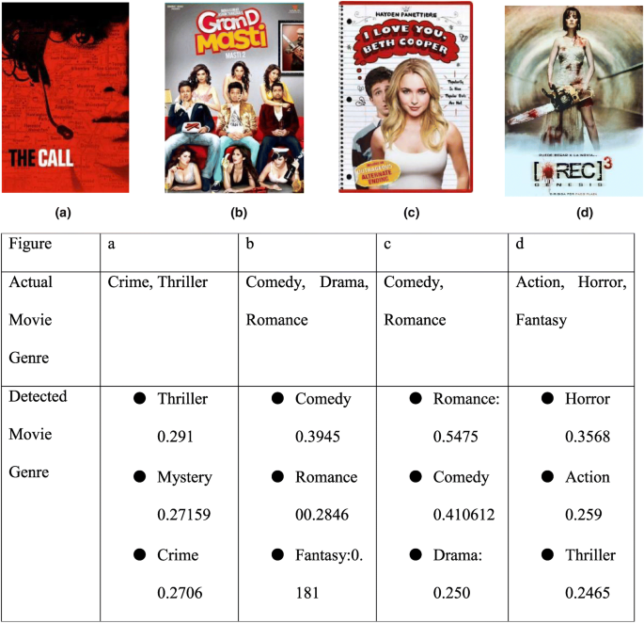
Multi-label classification of textual data is an important problem. Examples range from news articles to emails.
For instance, this can be employed to find the genres that a movie belongs to, based on the summary of its plot.

Slide 8
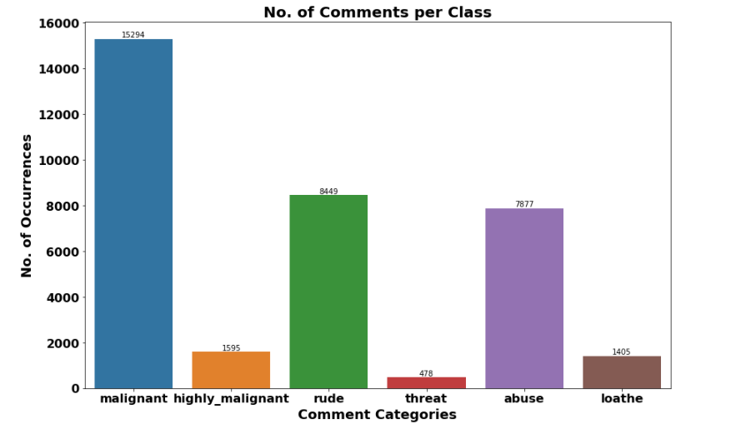
Exploration of Target Variable Ratings
Out of total Negative comments the maximum negative comments come with Malignant in nature followed by rude categories.
Around 90% comments are Good/Neutral in nature while rest 10% comments are Negative in nature.
Very few comments come with threatening nature.

Slide 9
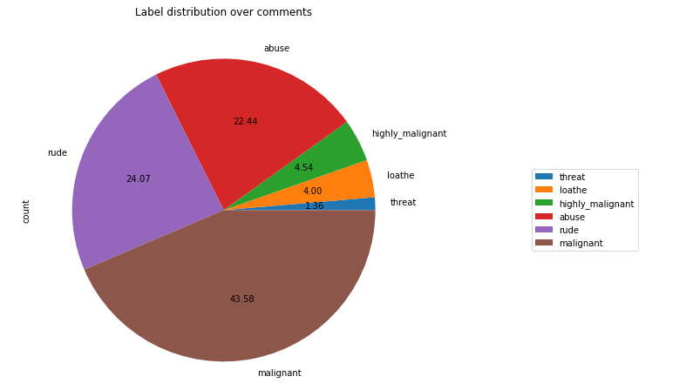
Out of total negative comments around 43.58% are malignant in nature followed by 24.07% are rude comments

Slide 10
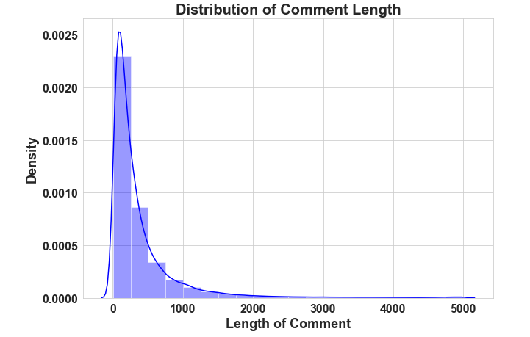
Above is a plot showing the comment length frequency. As noticed, most of the comments are short with only a few comments longer than 1000 words.
Majority of the comments are of length 500, where maximum length is 5000 and minimum length is 5. Median length being 250.

Slide 11
Data Pre Processing
Convert the text to lowercase
Remove the punctuation, digits and special characters
Tokenize the text, filter out the adjectives used in the review and create a new column in the data frame
Remove the stop words
Stemming and Lemmatising
Applying Text Vectorization to convert text into numeric

Slide 12
Multi-Label Classification Techniques
One Vs Rest
Binary Relevance
Classifier Chains
Label Powerset
Adapted Algorithm

Slide 13


Slide 14
Word Cloud for getting word sense
Word Cloud is a visualization technique for text data wherein each word is picturized with its importance in the context or its frequency.
The more commonly the term appears within the text being analysed, the larger the word appears in the image generated.
The enlarged texts are the greatest number of words used there and small texts are the smaller number of words used.

Slide 15
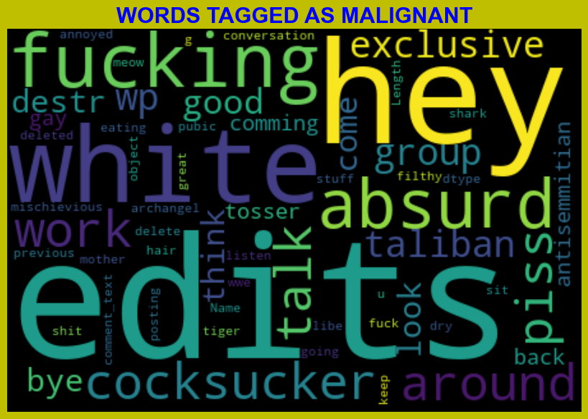
From word cloud of malignant comments, it is clear that it mostly consists of words like edits, hey, white, fucking, gay, cocksucker, work, think, Taliban etc

Slide 16
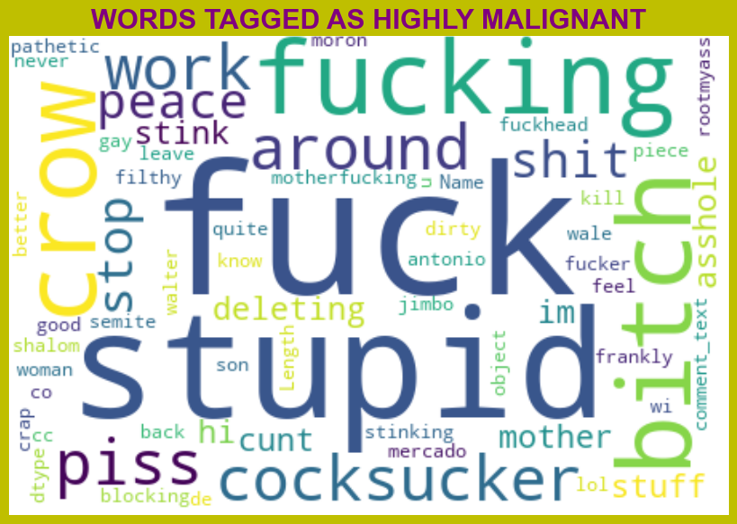
From word cloud of Highly malignant comments, it is clear that it mostly consists of words like fuck, stupid, fucking, bitch, crow, shit, cocksucker etc

Slide 17
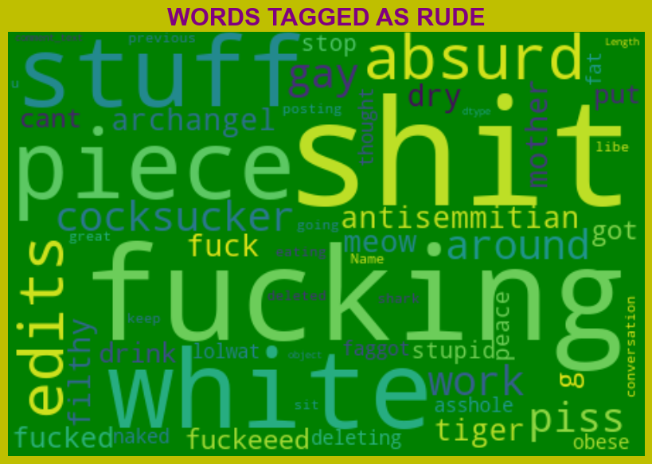
From word cloud of Rude comments, it is clear that it mostly consists of words like fucking, shit, white, piece, edits, stuff, absurd etc.

Slide 18
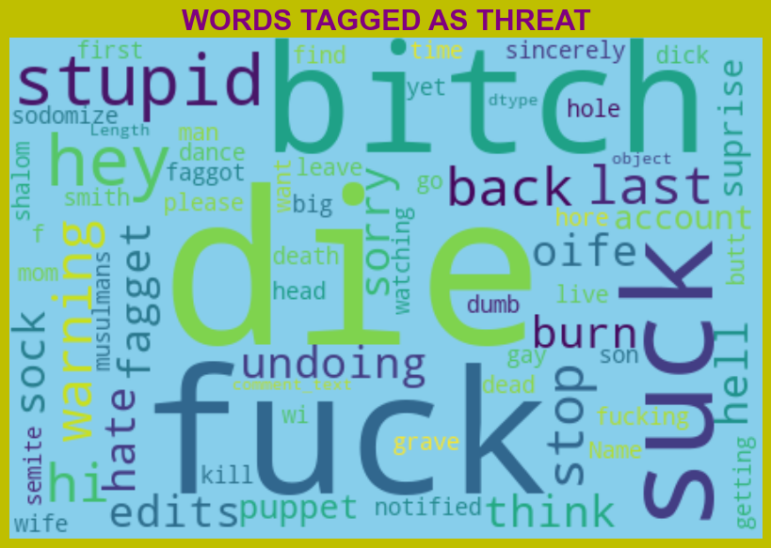
From word cloud of Threat comments, it is clear that it mostly consists of words like fuck, suck, Bitch, die, stupid, etc.

Slide 19
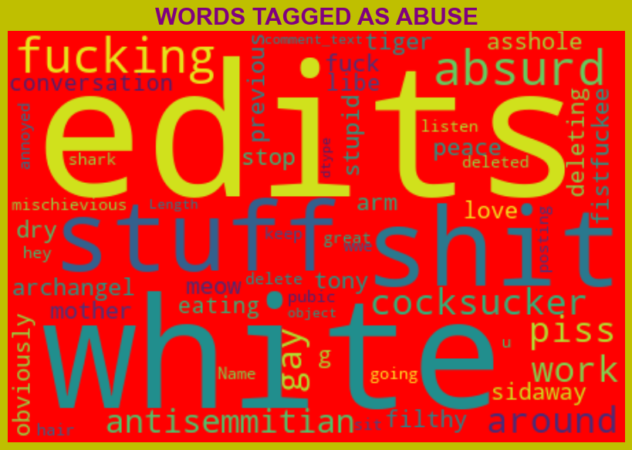
From word cloud of Abuse comments, it is clear that it mostly consists of words like edits, white, shit, stuff, fuck, piss, fucking etc.

Slide 20
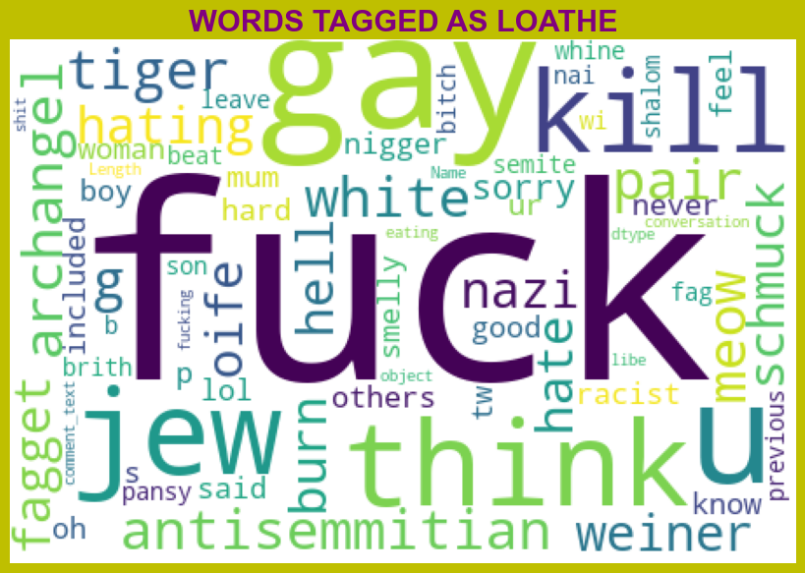
From word cloud of Loathe comments, it is clear that it mostly consists of words like fuck, gay, kill, think, jew, u etc.

Slide 21
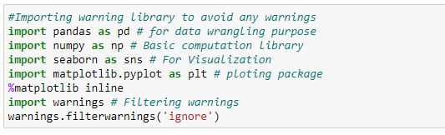
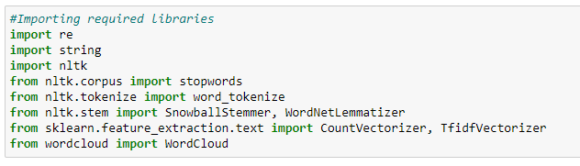
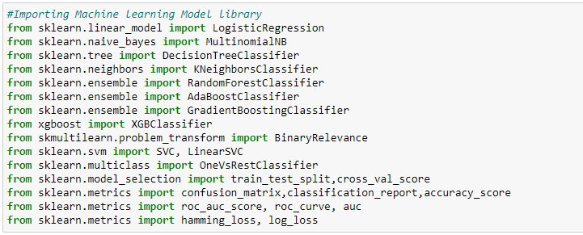
Visualization & Data Wrangling Library used
Text Mining Library used
Machine Learning Model Building Library used

Slide 22
Machine Learning Model Building

Slide 23
Machine Learning Model Building
The different classification algorithms used in this project to build the ML model are as below:
Random Forest classifier
Support Vector Classifier
Logistics Regression
AdaBoost Classifier

Slide 24

Machine Learning Evaluation Matrix
Support Vector Classifier gives a maximum Accuracy Score: of 91.1508 % and Hamming Loss: of 2.0953% than the other classification models.
Hyper parameter Tuning is performed over this best model using the best param shown below :

Slide 25
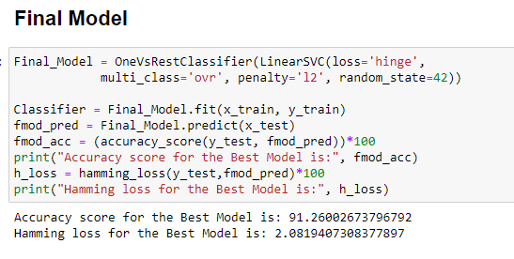
Final ML Model
Final Model is giving us Accuracy score of 91.26% which is slightly improved compare to earlier Accuracy score of 91.15%.

Slide 26
Machine Learning Evaluation Matrix
Algorithm | Accuracy Score | Recall (Micro) | Precision (Micro) | F1 Score (Micro) | Humming Loss
Logistics Regression | 0.9123 | 0.89 | 0.94 | 0.61 | 0.02206
Random Forest Classifier (RFC) | 0.9074 | 0.56 | 0.79 | 0.66 | 0.02191
Support Vector Classifier | 0.9115 | 0.56 | 0.82 | 0.67 | 0.02952
Ada Boost Classifier | 0.9057 | 0.50 | 0.80 | 0.61 | 0.9057
Algorithm | Accuracy Score | Recall (Micro) | Precision (Micro) | F1 Score (Micro) | Humming Loss
Logistics Regression | 0.9123 | 0.89 | 0.94 | 0.61 | 0.02206
Random Forest Classifier (RFC) | 0.9074 | 0.56 | 0.79 | 0.66 | 0.02191
Support Vector Classifier | 0.9115 | 0.56 | 0.82 | 0.67 | 0.02952
Ada Boost Classifier | 0.9057 | 0.50 | 0.80 | 0.61 | 0.9057

Slide 27
CONCLUSION
Linear Support Vector Classifier performs better with an Accuracy Score: of 91.15077857956704 % and Hamming Loss: of 2.0952019242942144 % than the other classification models.
Final Model (Hyperparameter Tuning) gives us an accuracy score of 91.26%, which is slightly improved compared to the earlier Accuracy score of 91.15%.
SVM classifier is the fastest algorithm compared to others.

Slide 28
Limitations of this work and Scope for Future Work
The Maximum feature used while vectorization is 2000. Employing more features in vectorization lead to a more accurate model which I could not employ due to computational resources.
Data is imbalanced in nature but due to computational limitations we have not employed balancing techniques here.
Deep learning CNN, and ANN can be employed to create a more accurate model.

